Slide 1



Learning about solar power, the life and death of an electron.
He was always
so negative
Baby Minus
Dave Strenski
March 2023

Slide 2
SolarYpsi History
2005
2007
2009
2011
2013
2015
Win $6k grant
4 panels on Co-op
City Hall solar fund raise $1050
Adams School $12k
TEDx video
Michigan Clean Energy Report
Google video, crash website
EnvMich Report
$10k for solar talks
SolarYpsi website by Nik Estep
1000 roof resolution
Letters to neighbors
Start solar talks
Grow Co-op system
Chasing Clean Air, CA radio podcast
QR tags
City Hall solar idea meet with the Mayor
Win City Hall,
Co-op grant $36k
Concentrate video
iTunesU video
$93.6k donation for six non-profits
$25k for Fire Station
SEIA video
Solar power Heritage Festival
NPR State Side
Win Bakery solar grant $44.6k
HomePower Mag.
Partner Chart House Energy
Cameron solar videos
Highland Cemetery
2006
2008
2010
2012
2014
2016
Slide 2

Slide 3
SolarYpsi History
2017
2019
2021
FireHouse Mag.
SolarToday Mag.
HomePower Mag.
17 res. solar projects
7 Solar Moonshot projects, $175k
DoE SunShot
50 Big roofs
Shining City top 20
3 Solar Moonshot projects, $75k
Scan all of Ypsilanti
Fire Station expansion
DPS expansion
First solar car port
Parkridge DoE proj.
Solar for City pool, $25k
Cem&Crem Mag.
2018
2020
Slide 3

Slide 4
sun
2005
2005
2005
2005
2007
2008
photovoltaic panels
2008
2008
2008
2008
2008
2008
Reverse
Meter
Forward
Meter
Sunny
Boy
disconnect
325
inverter
KWH
KWH
100
9885
534
utility meters
327
KWH
store meters
Gen Meter
breaker panel

Slide 5
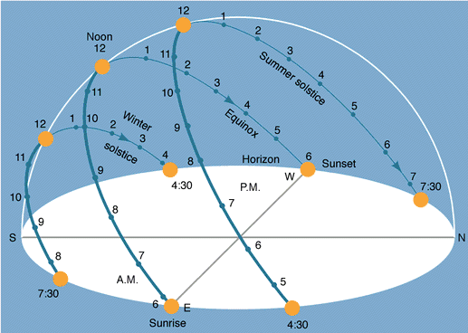
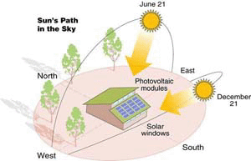
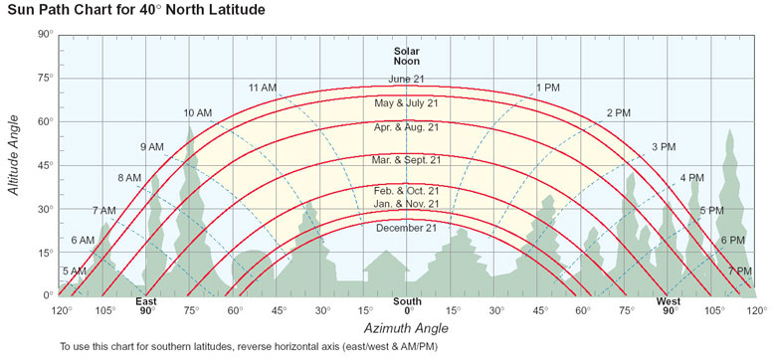

Slide 6
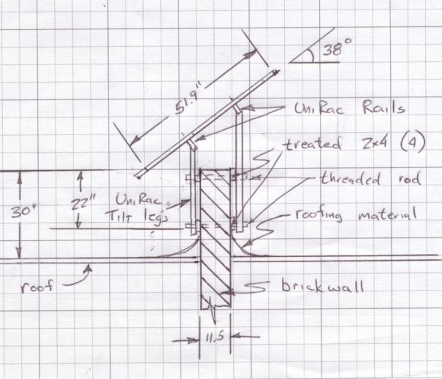
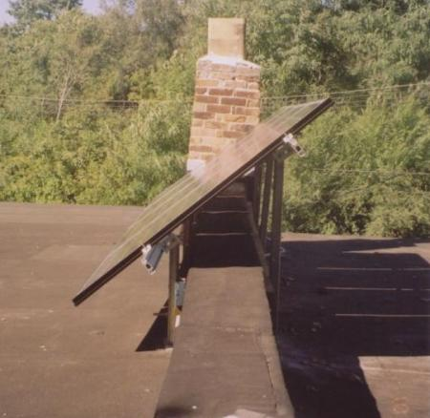
Tracking systems
Seasonal fixed panels
Fixed panels
Steeper for more uniform annual power
Flatter for maximum annual power

Slide 7

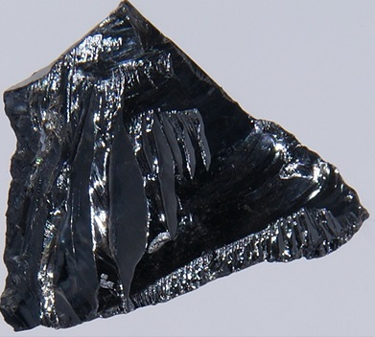
Silicon [Si]
shell 3
14 protons
+
n
14 neutrons
shell 1
shell 2
valence electrons

Slide 8
Silicon [Si]
shell 3
14 protons
+
n
14 neutrons
shell 1
shell 2
valence electrons

Slide 9
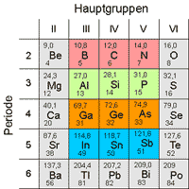
Building a Solar Cell
wires on the top
silicon doped with phosphorus
(few extra electrons)
silicon doped with boron
(holes, few less electrons)
wires on the bottom

Slide 10
photons
electrons
migrate up
holes migrate down

Slide 11
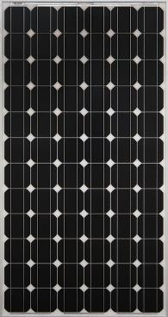
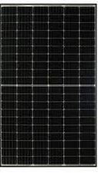
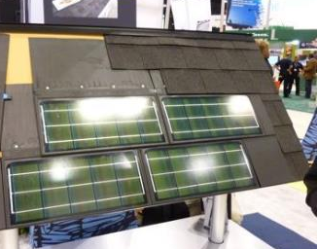
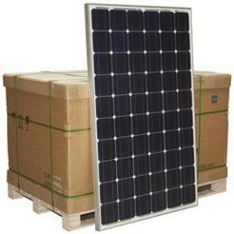
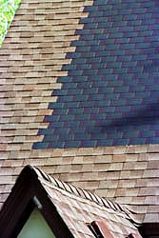
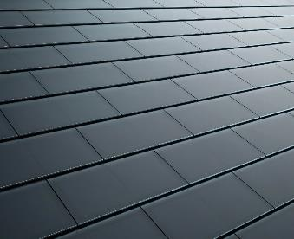
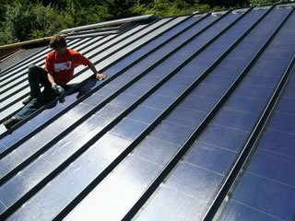
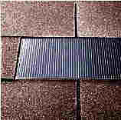
Mono and Polycrystalline Silicon
66”tall
380W
PowerHome
split-cell
60 cell
72 cell
40” x 79”
450-watts
Uni-Solar
Amorphous Silicon
Tesla
Uni-Solar

Slide 12
sun
2005
2005
2005
2005
2007
2008
photovoltaic panels
2008
2008
2008
2008
2008
2008
Reverse
Meter
Forward
Meter
Sunny
Boy
disconnect
325
inverter
KWH
KWH
100
9885
534
utility meters
327
KWH
store meters
Gen Meter
breaker panel

Slide 13
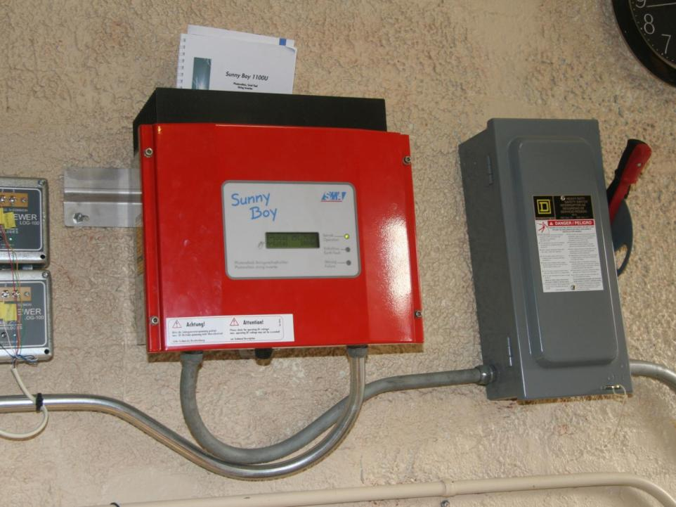
DC
UL listed
Clean power
Shuts offs if grid is down
Powered by solar
Quite and Cool
Displays power generated
voltage
time
AC
voltage
time
AC out
DC in

Slide 14
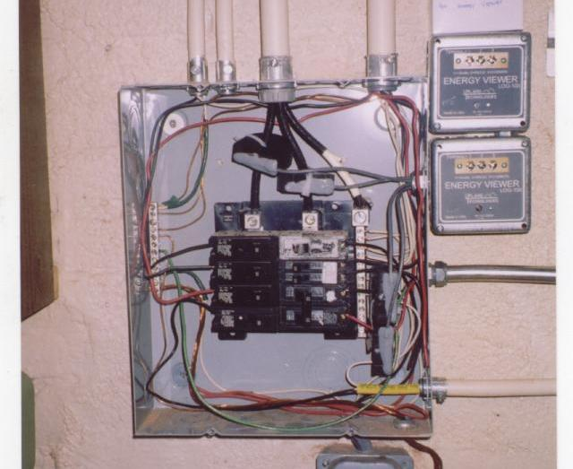
Standard breaker
240 volt, 20 amp
back fed

Slide 15
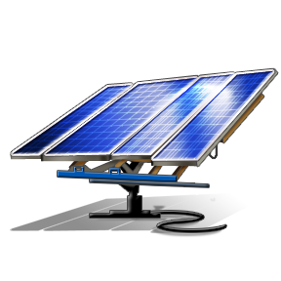
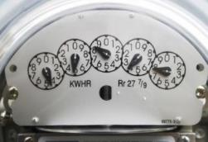
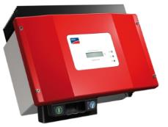
4:00 am
forwards
OFF

Slide 16

8:00 am
forwards
direct
current
alternating
current

Slide 17

11:00 am
forwards
direct
current
alternating
current

Slide 18

1:00 pm
backwards
direct
current
alternating
current

Slide 19
Power is distributed to the neighborhood
Utility supplies power to the transmission lines
Solar panels start generating power

Slide 20
One less shovelful of coal is needed at the utility power plant
Power is distributed to the neighborhood
Utility supplies power to the transmission lines
Solar panels start generating power

Slide 21
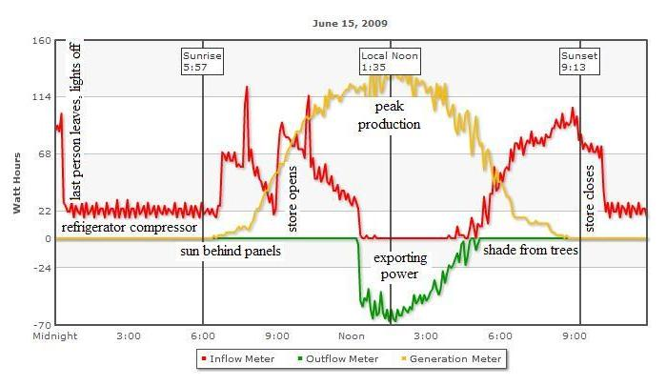

Slide 22
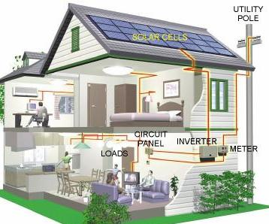
Average Michigan home
668 kWh/month (average month)
18.11c per kWh, $121/month (2023)
668 kWh / 30 days = 22 kWh (average day)
https://www.michigan.gov/-/media/Project/Websites/mpsc/consumer/electric/rates1.pdf?rev=959038e92dbd465a9293dd7152009d4f
Solar Economics

Slide 23
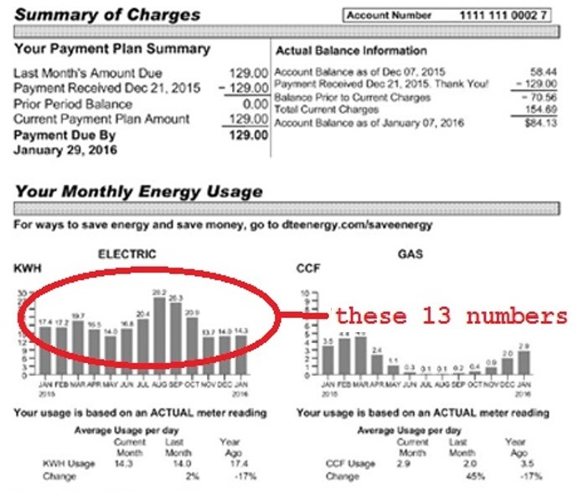

Slide 24
Average Michigan home
668 kWh/month (average month)
18.11c per kWh, $121/month (2023)
668 kWh / 30 days = 22 kWh (average day)
Solar Economics
4 hour of sun per day, assuming panels are facing south tilted at your latitude.
Assume 20% loss for system efficiency and some shading
22 kWh / 4 hr * 1.2 = 6.6 KW
6600 watts would be about 16 solar panels at 410W per panel. (2 x 8 array, 13’ x 27’)

Slide 25
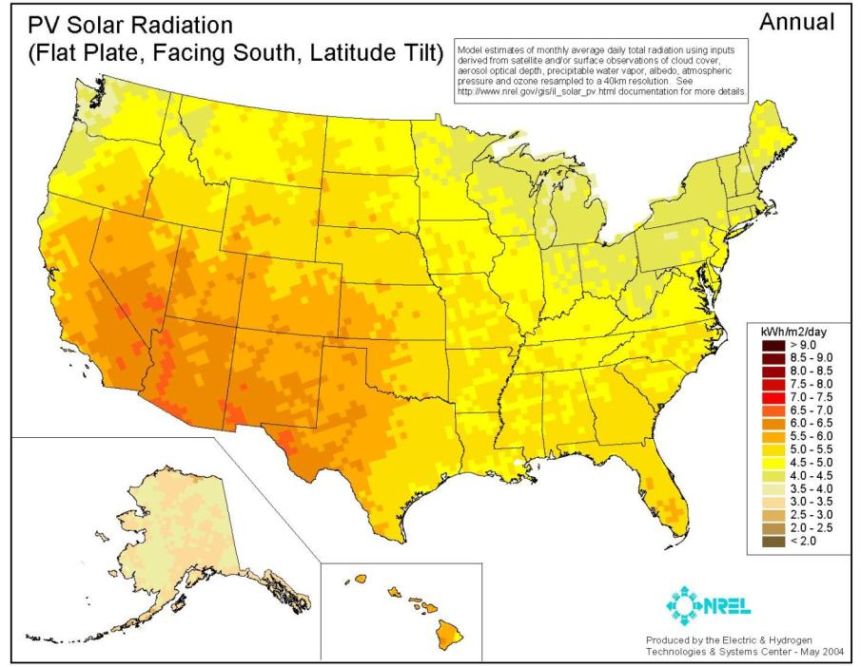

Slide 26
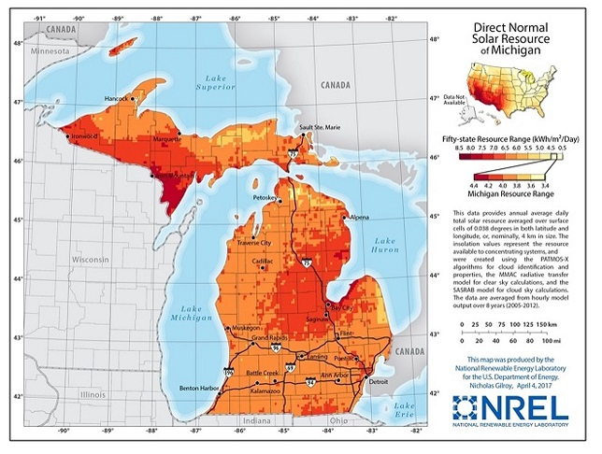

Slide 27
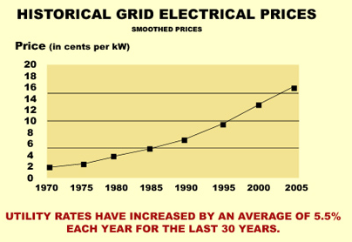
Average Michigan home
668 kWh/month (average month)
18.11c per kWh, $121/month (2023)
668 kWh / 30 days = 22 kWh (day)
Solar Economics
4 hour of sun per day, assuming panels are facing south tilted at your latitude.
Assume 20% loss for system efficiency and some shading
22 kWh / 4 hr * 1.2 = 6.6 kW
6600 watts would be about 16 solar panels at 410W per panel. (2 x 8 array, 13’ x 27’)
Solar installation cost = $3.0 per watt $3.5 per watt
6600W x $3/W = $19,800 6600W x $3.5/W = $23,100
$19,800 x 0.30 = -$5,940 $23,100 x 0.30 = -$6,930
$13,860 $16,170
6.6 kW x 4 hr x $0.1811 = $4.78/day
$4.78 x 365 days = $1,745/year
@ $3.0/watt $13,860 / $1,745 = ~8 years ROI
@ $3.5/watt $16,170 / $1,745 = ~9 years ROI
City of Ypsilanti
@ $3.0/watt ($13,860-$2000) / $1,745 = ~7 years
@ $3.5/watt ($16,170-$2000) / $1,745 = ~8 years

Slide 28
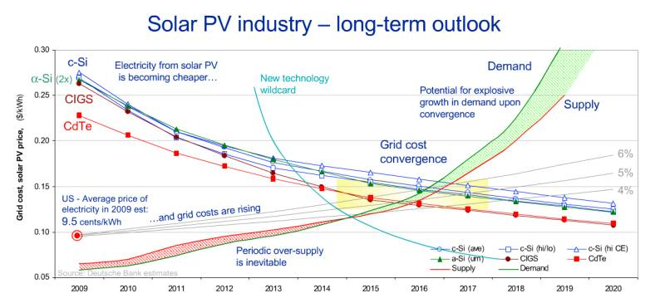
Solar Economics

Slide 29
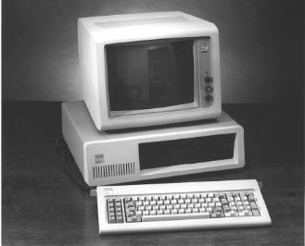
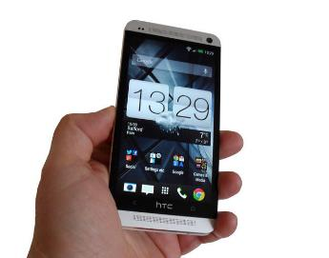
Economics of Scale
Intel 80486 PC
Purchased in 1990 for $2000
16 MB of Memory, 50 MHz clock
50 pounds and BIG.
Samsung Galaxy Nexus
2013 for $200
32 GB , 1.2 GHz clock, dual-core
5 ounces and fits in your pocket
23 years = 10x cheaper, 2000x memory, 48x faster, 160x lighter

Slide 30
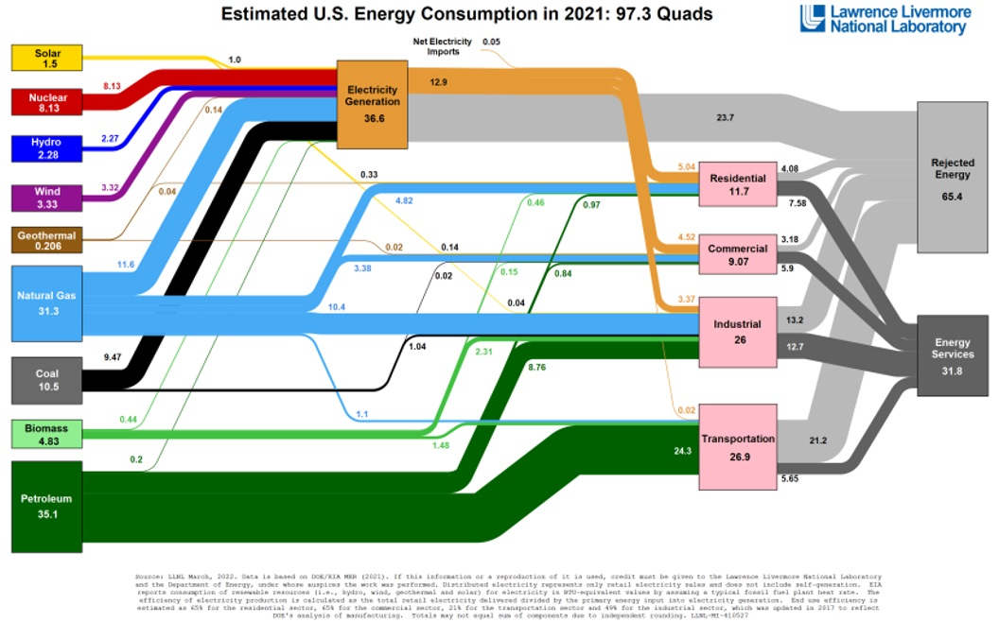
4% solar
35% useful
65% lost
9% wind
79% lost
21% useful

Slide 31


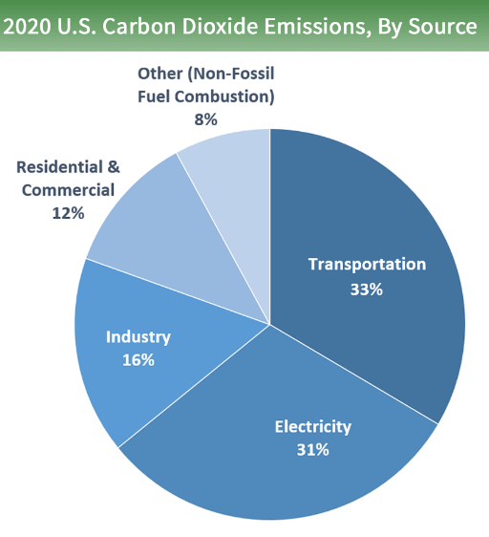



Slide 32
